Slide 1
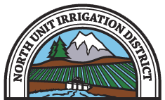
North Unit Irrigation District
Crooked River Water Quality and Supply Reliability Pumping Plant

Slide 2
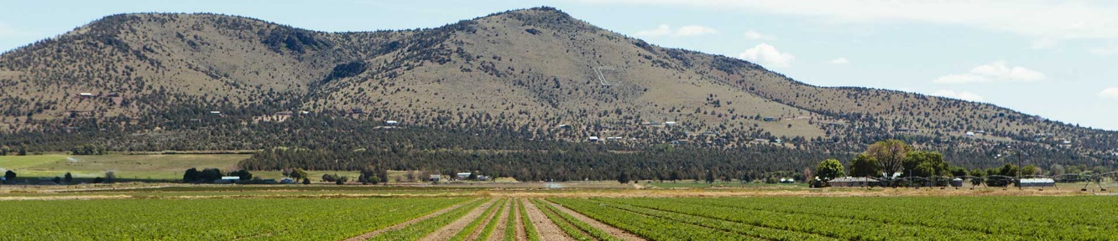
North Unit Irrigation District (NUID)
NUID - located in the Lower Basin, east of Lake Billy Chinook in Jefferson County, Oregon - is the largest irrigation district in the Deschutes River Basin, consisting of approximately 59,000 irrigated acres of high-value crops.
Water supply for the District consists of water rights from both the Deschutes and Crooked Rivers, with water from both sources conveyed and delivered through the Federal Deschutes Project. The existing Crooked River Pump Station diverts NUID’s Crooked River water rights into the North Unit Main Canal.
Endangered Species Act (ESA) concerns in the Upper Basin have led to a Habitat Conservation Plan (HCP) which is expected to significantly reduce NUID’s Deschutes River water supplies stored in Wickiup Reservoir. Historically, NUID has received over 60% of its annual water supply from Wickiup Reservoir storage releases.

Slide 3
The Project
Drought conditions and increased impact from ESA related flow requirements in 2020 and 2021 have highlighted the need to construct the Crooked River Water Quality and Supply Reliability Project to increase the reliability of water for farms and the environment.
The project includes a new 400 cfs pumping plant from Lake Billy Chinook (LBC), a pipeline, and a new or expanded regulating reservoir, which will tie into existing Deschutes Project facilities.
Preliminary analysis of the proposed pumping station, pipeline and regulating facilities estimates construction costs range from $350-$440 million
NUID believes the cost can be reduced to the $200-$300 million range if the alternative location is used and existing facilities are leveraged.
Proposed Pipeline
Alternate Pumping Plant Site and Associated Facilities
Haystack Disharge to NUID Main Canal
Spill into NUID Main Canal
Haystack Reservoir

Slide 4
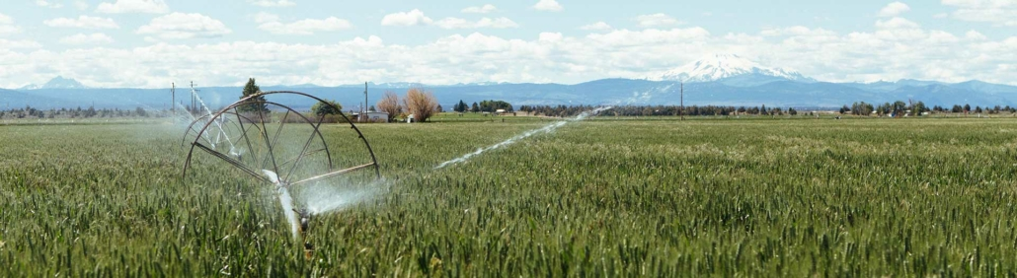
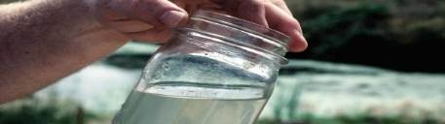
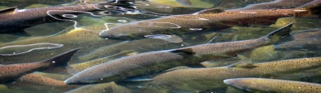
Water Reliability and Environmental Benefits
Water Reliability Benefits
Water Quality Benefits
Instream Flow Benefits
A new pumping station on LBC will provide significant water reliability benefits, boosting available water supply up to 60,000 AF by:
Allowing the NUID to pick up its Crooked River water lower in the system with less risk of disruption.
Increasing operational flexibility of the Deschutes Project and allow greater recovery of the District’s Deschutes River water otherwise lost due to winter release requirements.
Opening optional future water marketing opportunities.
Water quality concerns in the Lower Crooked River include elevated temperatures, high pH, and nutrient loading.
Reduced diversions by NUID are expected to improve water quality (particularly temperature) in the Lower Crooked River.
The project is expected to help basin water users achieve anticipated TMDL targets at low cost.
The Lower Crooked River is the focus of efforts significant financial investments to reestablishment of salmon and steelhead populations.
This project will reduce existing diversions from the Crooked River by about 20,000 acre-feet per year.
Flow enhancements will be significant in July and August and are estimated to be over 130 cfs at times. This stretch of river ran virtually dry during this period in 2021.
Other conservation projects on the Crooked River indicate potential benefits of up to $9M in avoided costs.

Slide 5
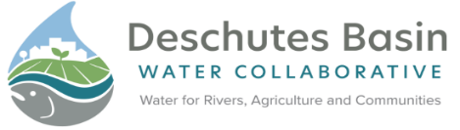
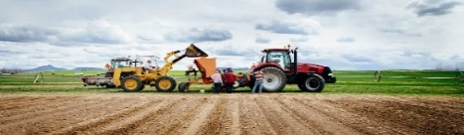
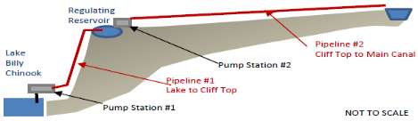
Additional Benefits
Water Cooperation Benefits
Agricultural Benefits
Renewable Energy Benefits
For decades, water interests in the Deschutes Basin have come together to address unique water challenges of the basin and plan for its future. This project seeks to continue that spirit of cooperation by bringing together diverse groups in a unique way that best utilizes the Basin’s water resources.
Enhanced water supply to NUID farmers is a primary benefit of the project. Impacts from the HCP are intended to be offset by the project. Annual benefits to NUID farmers are expected to be $4M to $6M from increased supply and improved crop yields.
The potential to utilize the pumping facility infrastructure in reverse, known has pumped storage, could generate as much as 8,000 kW at peak production. Stored water can be released to flow downhill to spin turbines (pump turbines) thereby generating power.

Slide 6
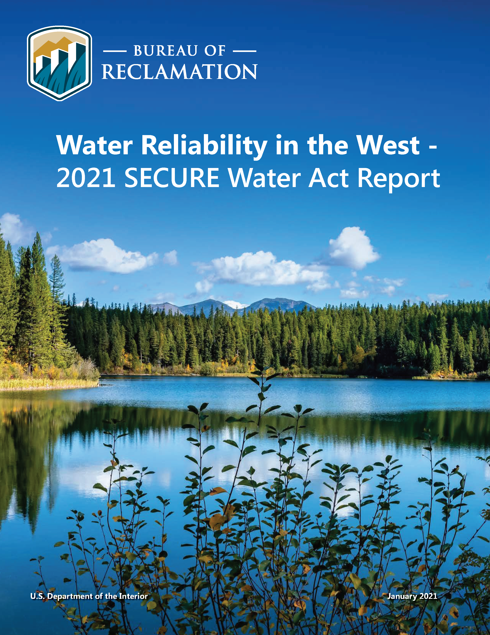
Status and Next Steps
Significant work has been done to prepare the Crooked River Ecosystem Improvement and Water Reliability Pumping Plant Project to move forward.
It draws from findings and analysis in multiple Reclamation studies: the Upper Deschutes River Basin Study, Crooked River Dry-Year Management Plan, and WaterSMART funded Warm Springs Water Marketing Project Study, among others.
NUID has met with over 20 tribal, environmental, water user, agricultural, and governmental stakeholders to present the preliminary project concept.
This project will begin to implement identified solutions to long-standing challenges in our region.
The next step is for NUID and Reclamation to initiate a Feasibility Study on this Project

Slide 7
Existing Authorities
Original Authorization - Pub. Res. No. 32, of June 7, 1924, ch. 374,43 Stat. 668
[Plans for constructing and completing projects to be submitted to Congres+ Contribution of one-half of cost by States. ] —The Secretary of the Interior is hereby authorized and directed to prepare and submit to Congress at the beginning of the next regular session plans and estimates of the character and cost of structures necessary for the construction and completion of the proposed Casper-Alcova irrigation project in .Natrona County, Wyoming; the Deschutes project in the State of Oregon, and the Southern Lassen Irrigation project, in Lassen County, California; Provided, That at least one-half of the cost of such investigations, plans and estimates shall be advanced by the State in which the project is located, or by parties interested. (43 Stat. 668).
Secure Water Act - Omnibus Public Land Management Act of 2009 (P.L. 111-11)
SEC. 9503. RECLAMATION CLIMATE CHANGE AND WATER PROGRAM. (42 U.S.C. 10363)
(d) FEASIBILITY STUDIES.—(1) AUTHORITY OF SECRETARY.—The Secretary, in cooperation with any non-Federal participant, may conduct 1 or more studies to determine the feasibility and impact on ecological resiliency of implementing each mitigation and adaptation strategy described in subsection (c)(3), including the construction of any water supply, water management, environmental, or habitat enhancement water infrastructure that the Secretary determines to be necessary to address the effects of global climate change on water resources located in each major reclamation river basin.
Aquatic Ecosystem Restoration Program - Consolidated Appropriations Act, 2021 (P.L. 116-260)
SEC. 1109. AQUATIC ECOSYSTEM RESTORATION.
(b)(1) IN GENERAL.—Subject to the requirements of this section and paragraph (2), on request of any eligible entity the Secretary may negotiate and enter into an agreement on behalf of the United States to fund the design, study, and construction of an aquatic ecosystem restoration and protection project in a Reclamation State if the Secretary determines that the project is likely to improve the health of fisheries, wildlife or aquatic habitat, including through habitat restoration and improved fish passage via the removal or bypass of barriers to fish passage.

Slide 8
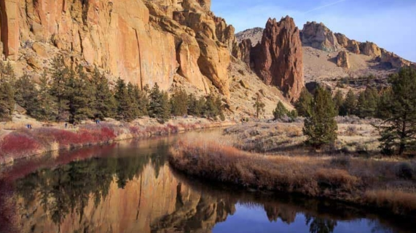
Questions and Discussion

